Slide 1
MALLA REDDY UNIVERSITY R-22 III YEAR B.TECH. (CSE) / II – SEM MR22-1CS0108 Cloud Computing

Slide 2
UNIT V
Azure SQL Database: Understanding Database as a service, Azure SQL Data Warehouse.
Azure Cosmos DB: Introduction, request unit, Partition Strategy and Key, Query types
Networking: Azure VNet, Traffic Manager.

Slide 3
Understanding Database as a service
What is Database-as-a-Service?
DBaaS (Database as a service) is a cloud computing managed service offering model that enables users to set up, operate, manage and scale with some form of access to a Database without the need for setting it up on physical hardware, installing software, or configuring it for performance, Database management by themselves.
It has come up as a wonderful approach that extends the capabilities of the Private Cloud by Increasing Quality of Service, Faster Deployment, Providing Resource Elasticity, Rapid Provisioning. Moreover, DBaaS in Enterprise Manager is implemented by four options, which are: Virtual Machine based, Shared Cluster, Shared installation, Shared Database.
Databases are generally available in two forms, namely: SQL and NoSQL. SQL (i.e., Search Query Language) is a programming language used to build many Databases. A NoSQL Database like MongoDB is more flexible and can make changes instantaneously, making it feasible for the queries and information responses to be situational.

Slide 4
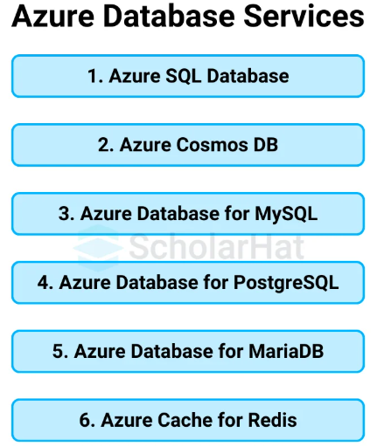
Understanding Database as a service
Types of Azure Database Services
Azure offers a wide range of database services to cater to different use cases, whether for relational, NoSQL, or data warehousing needs. Some of the primary Azure database services:

Slide 5
Understanding Database as a service
1. Azure SQL Database:
Azure SQL Database performs similarly to a fully managed SQL Server instance. If you've ever handled SQL Server on-premises, you'll appreciate the ease Azure offers. Azure provides infrastructure(IaaS) for you, so there's no need to manage it.
It also includes modern technologies like AI and machine learning to boost performance.
It follows Multi-Tenant Architecture i.e it Operates on a shared-resource model but ensures you get the performance you need through resource governance.
These include general purpose, business-critical, and hyper-scale tiers to suit different performance needs.
2. Azure Cosmos DB
Global Distribution: Cosmos DB is a globally distributed NoSQL database service; hence, your data will be made available for users in other regions with low-latency performance.
Multiple Data Models: It supports various models, such as key-value, document, graph, and column family representation of data, making it flexible with respect to different applications.
Automatic Scaling: Cosmos DB can automatically scale to demand requirements for throughput and storage in your application and efficiently process volumes that are very high.
Multi-Master Replication: This feature provides high availability through replication across multiple regions, ensuring consistency in data.
Guaranteed SLAs: It comes with guaranteed SLAs where throughput, latency, consistency, and availability are guaranteed to provide predictable user experiences.

Slide 6
Understanding Database as a service
3. Azure Database for MySQL
Setting up, running, and scaling MySQL databases on the cloud is made simple with Azure Database for MySQL, a fully managed MySQL database service.
You may utilize your MySQL database just like any other, but much more conveniently, Azure take care of the infrastructure, security, and patching.
Includes encryption of data, security, and compliance with industrial standards to keep your data protected.
It offers excellent availability and Automatic Scaling designed to grow with the needs of your application.
Offers different pricing tiers. Every customer pays for what they use and scales up when needed.
4. Azure Database for PostgreSQL
A completely managed service built on top of the open-source PostgreSQL architecture is Azure Database for PostgreSQL.
This solution streamlines PostgreSQL database deployment, administration, and scalability in the cloud.
You can concentrate on developing your applications while taking advantage of enhanced performance, security, scalability, and high availability when your application needs to expand by using Azure infrastructure.
Offers multitier pricing, pays for what you use and scales up as demand grows.

Slide 7
Understanding Database as a service
5. Azure Database for MariaDB
Azure Database for MariaDB is a cloud-based MariaDB service that makes it easier to run, manage, and scale MariaDB databases.
Azure handles infrastructure duties like backups, security, and upgrades so you can focus on developing and expanding your apps.
It is designed to expand to meet the demands of your application while preserving performance and availability.
It provides a wide range of security measures for blocking unauthorized access to the data, including encryption
and adherence to the relevant regulations.
6. Redis Cache in Azure
Azure Cache for Redis is a distributed, in-memory cache solution that provides faster and scalable caching to applications.
The performance of an application is improved by storing the frequently accessed data in memory, which reduces the load on your backend to ensure data access with minimal latency while security and availability are maintained, scaling seamlessly into Azure.
Offers data persistence options, allowing you to save your cache data to disk for backup and recovery.

Slide 8
Azure SQL Data Warehouse
Azure SQL Data Warehouse is a managed Data Warehouse-as-a Service (DWaaS) provided by Microsoft Azure.
A data warehouse is a federated repository for data collected by an enterprise's operational systems.
Azure SQL Data Warehouse was first released in July of 2016 and enables businesses to centrally consolidate and provide global access to their data warehouse for analytics and reporting.
This service includes scalability with Azure cloud resources and utilizes Massively Parallel Processing (MPP) to deliver rapid query execution over large amounts of data.
Traditional or enterprise data warehousing solutions simply aren’t scalable enough or cost-effective to support the petabytes of data we generate.
The need to mitigate the risks and issues in a traditional data warehouse inspired change that led to the birth of cloud or modern data warehousing.
A modern data warehouse lets you bring together all your data at any scale easily. It allows access to insights through analytical dashboards, operational reports or advanced analytics for all your users. And, it combines all your structured, unstructured, semi-structured and streaming data.

Slide 9
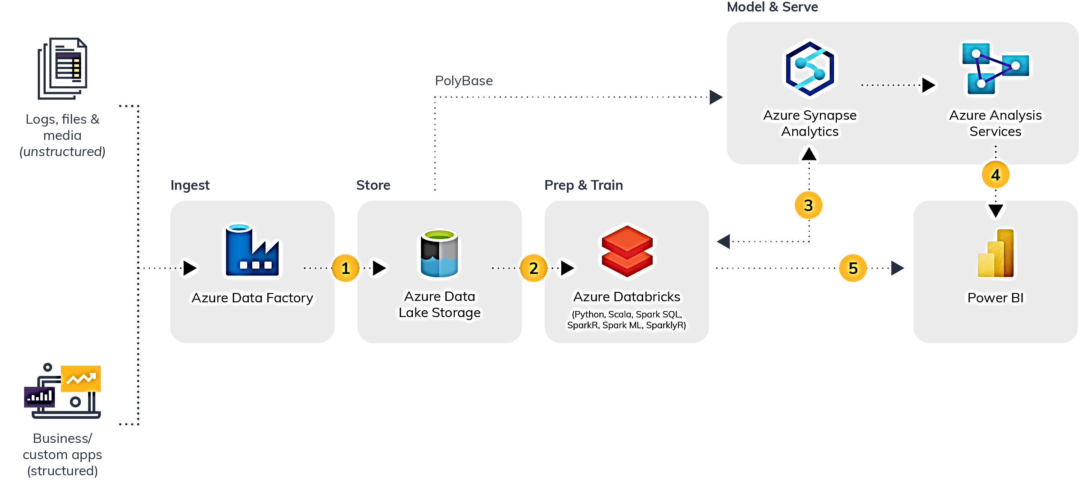
Azure SQL Data Warehouse
Modern Data Warehousing Before Azure Synapse Analytics:
When it comes to cloud storage at an enterprise level, we all think about a data lake, which is raw storage of all structured and unstructured data. Some companies use Delta Lake on top of their data lake, which is like a software layer to implement the atomicity, consistency, isolation and durability (ACID) transactions and many more features to the Data Lake.

Slide 10
Azure SQL Data Warehouse
The above diagram is a classic example of a modern data warehouse in the Microsoft Azure environment. In Microsoft Azure, we refer to a data lake as Azure Data Lake Storage Gen 2 (ADLS Gen 2).
Before Azure Synapse launched, we used multiple tools to manage our data warehouse. For ingesting and processing the data in the data lake, we used Azure Data Factory (ADF) to transform the data and orchestrate the different activities involved in the extract, load and transform (ELT) process.
To prepare and transform the data, we used Azure Databricks. To store the processed data, we needed a warehouse so we used Azure SQL Data Warehouse (rebranded as Synapse Analytics in 2020).
And finally, we need to integrate with reporting tools like Power BI to create reports on the facts and dimension tables.
We needed each of these separate tools to process our data from start to finish.

Slide 11
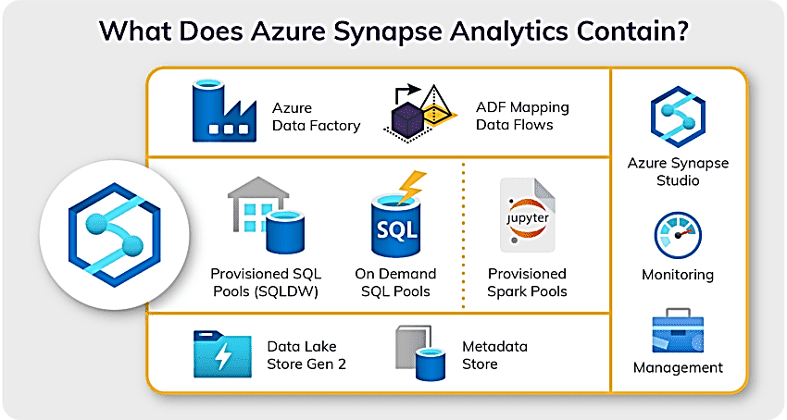
Azure SQL Data Warehouse
How Azure Synapse Analytics Changed the Game?
On November fourth, it is announced Azure Synapse Analytics, the next evolution of Azure SQL Data Warehouse. Azure Synapse is a limitless analytics service that brings together enterprise data warehousing and Big Data analytics.
Azure Synapse brings all the platforms of a data engineering project like a data lake, ELT/ETL, a warehouse and reporting under one roof.

Slide 12
Azure SQL Data Warehouse
Azure Synapse Analytics is a unified platform for data engineering projects where the developers can:
Interact with the data present in the data lake (ADLS Gen 2).
Create Linked services to connect with over 90 source systems.
Create Spark notebooks or copy activity to copy data from the data lake or source systems.
Access analytical pools like a serverless SQL pool, dedicated SQL pool and Apache Spark pool to process the data.
Transform the data using SQL scripts, notebooks and data flows (a graphic user interface or GUI).
Train models with Azure Machine Learning automated ML.
Orchestrate different tasks in one pipeline and schedule them to run periodically.
Create and access Power BI reports.
Monitor all the tasks running in Azure Synapse Analytics
Manage all the access controls and credentials based on assigned roles.

Slide 13
Introduction to Azure Cosmos DB
Azure Cosmos DB:
Cosmos Database (DB) is a globally distributed, low latency, multi-model database for managing data at large scales. It is a cloud-based NoSQL database offered as a PaaS (Platform as a Service) from Microsoft Azure. It is a highly available, high throughput, reliable database and is often called a serverless database. Cosmos database contains the Azure Document DB and is available everywhere.
The key features of Cosmos DB are:
Globally Distributed: With Azure regions spread out globally, the data can be replicated globally.
Scalability: Cosmos DB is horizontally scalable to support hundreds of millions of reads and writes per second.
Schema-Indexing: This enables the automatic indexing of data without schema and index management.
Multi-Model: It can store data in Key-value Pairs, Document-based, Graph-based, Column Family-based databases. Global distribution, horizontal partitioning, and automatic indexing capabilities are the same irrespective of the data model.
High Availability: It has 99.99 % availability for reads and writes for both multi region and single region Azure Cosmos DB accounts.
Low Latency: The global availability of Azure regions allows for the global distribution of data, which further makes it available nearest to the customers. This reduces the latency in retrieving data.

Slide 14
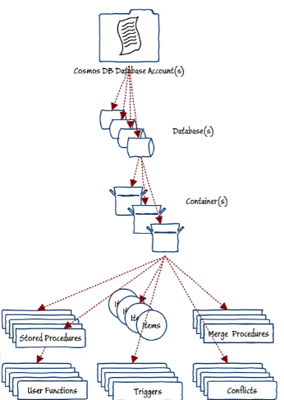
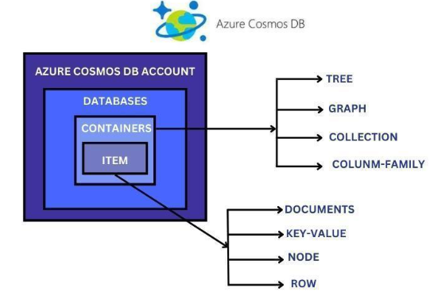
Introduction to Azure Cosmos DB
Cosmos DB database design :

Slide 15
Introduction to Azure Cosmos DB
Cosmos DB database design :
Databases
Cosmos DB ‘database account‘ is referred to as the Cosmos DB resource in Azure itself which holds one or more databases. The database is the unit of management for a set of cosmos containers. You can have multiple databases in an account based on your requirements.
There are multiple options for API to choose from for your databases like SQL API, Cassandra, MongoDB, Table API, and Gremlin. CosmosDB handles the different translations and communication for you so that you have a similar experience while working with all types of databases. The API configured on Account level not in Container. So in case If you created Cosmos DB Account with SQL API this means any container will be created on this Cosmos DB account will be working on SQL API and this configuration can not be changed after creating it.
Containers
CosmosDB containers are the units inside the database that govern scalability for both throughput and storage. Containers are horizontally partitioned and then replicated across multiple regions. The items inside a container are automatically distributed based on the partition key.
Items
Item is a unique entry inside a container that holds the data as a document, node, or row. Based on the API used, the items can represent either a document in a collection, a row in a table, or a node/edge in a graph.

Slide 16
Introduction to Azure Cosmos DB
Multi-level Consistency in CosmoDB
Consistency indicates whether the data are in sync and are at the same state at any given point in time.
Cosmos DB offers multiple levels of consistency with varying performances and availability
.
The various consistency levels offered are:
Eventual: Here the data is written on the primary node and is propagated eventually to read-only secondary nodes. It might take some time for the users to get updated data.
Consistent Prefix: Clients can read data in the same order as it is written.
Session: Users who just committed the data will be able to see it but it will take some time for the others to get that data version.
Bounded Staleness: Here a staleness period can be set, for which the data won’t be replicated into the secondary nodes.
Strong: This offers the latest copy of data for all the users but gives a relatively low performance.
Cosmos DB allows us to set a default consistency while creating it and which can be changed from the application while retrieving data.

Slide 17
Introduction to Azure Cosmos DB
Working of Cosmos DB
For example
We are developing a global e-commerce application with Azure Cosmos DB. The application must store product information, customer data, and transaction details.
Azure Cosmos DB allows you to create separate containers for each data type, ensuring efficient storage and retrieval.
By leveraging the global distribution feature, customers from different regions can quickly access the application and retrieve product information.
The partitioning capability ensures that the database scales seamlessly as the number of products and customers grows. With automatic indexing, you can quickly search products based on various attributes
.
The chosen consistency model ensures customers see the most up-to-date product information during their shopping experience.

Slide 18
Request Unit of Azure Cosmos DB
Azure Cosmos DB supports many APIs, such as SQL, MongoDB, Cassandra, Gremlin, and Table. Each API has its own set of database operations. These operations range from simple point reads and writes to complex queries. Each database operation consumes system resources based on the complexity of the operation.
Azure Cosmos DB normalizes the cost of all database operations using Request Units (or RUs, for short) and measures cost based on throughput (Request Units per second, RU/s).
Request unit is a performance currency abstracting the system resources such as CPU, IOPS, and memory that are required to perform the database operations supported by Azure
Cosmos DB. Whether the database operation is a write, point read, or query, operations are always measured in RUs.
For example,
A point read (fetching a single item by its ID and partition key value) for a 1-KB item is one Request Unit (or one RU), no matter which API you use to interact with your Azure Cosmos DB container. You can model your throughput costs using the Azure Cosmos DB Capacity Calculator.

Slide 19
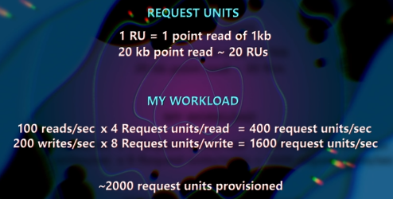
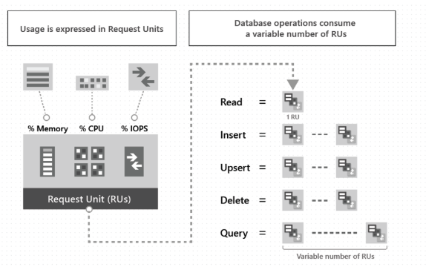
Request Unit of Azure Cosmos DB

Slide 20
Request Unit of Azure Cosmos DB
The type of Azure Cosmos DB account you're using determines the way consumed RUs get charged.
There are three modes in which you can create an account:
Provisioned throughput mode: In this mode, you assign the number of RUs for your application on a per-second basis in increments of 100 RUs per second. To scale the provisioned throughput for your application, you can increase or decrease the number of RUs at any time in increments or decrements of 100 RUs. You can make your changes either programmatically or by using the Azure portal. You're billed on an hourly basis for the number of RUs per second you've provisioned.
Serverless mode: In this mode, you don't have to assign any throughput when creating resources in your Azure Cosmos DB account. At the end of your billing period, you get billed for the number of Request Units consumed by your database operations.
Autoscale mode: In this mode, you can automatically and instantly scale the throughput (RU/s) of your database or container based on its usage. This scaling operation doesn't affect the availability, latency, throughput, or performance of the workload. This mode is well suited for mission-critical workloads that have variable or unpredictable traffic patterns, and require SLAs on high performance and scale.

Slide 21
Request Unit of Azure Cosmos DB
Request Unit considerations
While you estimate the number of RUs consumed by your workload, consider the following factors:
Item size: As the size of an item increases, the number of RUs consumed to read or write the item also increases.
Item indexing: By default, each item is automatically indexed. Fewer RUs are consumed if you choose not to index some of your items in a container.
Item property count: Assuming the default indexing is on all properties, the number of RUs consumed to write an item increases as the item property count increases.
Indexed properties: An index policy on each container determines which properties are indexed by default. To reduce the RU consumption for write operations, limit the number of indexed properties.
Data consistency: The strong and bounded staleness consistency levels consume approximately two times more RUs while performing read operations when compared to that of other relaxed consistency levels.
Type of reads: Point reads cost fewer RUs than queries.
Query patterns: The complexity of a query affects how many RUs are consumed for an operation live number of query results, size of the source data, size of the result set etc..
Script usage: As with queries, stored procedures and triggers consume RUs based on the complexity of the operations that are performed.

Slide 22
Partition Strategy and Key
Azure Cosmos DB Partition
Azure Cosmos DB is designed to be used and operate for any size of workloads without any
special configuration required to adapt to workload changes.
That’s all possible due to its scalable nature, and most importantly, the scalability is all taken care by the Azure team so that you can spend more time writing efficient code and queries to interact with your data.
Azure Cosmos DB uses horizontal partitioning to scale out data. It then distributes the data across many partitions, each served by a different server.
By sharing the load across multiple servers, horizontal partitioning helps the database provide high throughput and storage.

Slide 23
Partition Strategy and Key
Azure Cosmos DB Partition Keys
The most important element of the horizontal partitioning strategy is the partition key—
a property associated with all the items stored in the container. You define the partition key when creating
a container in Azure Cosmos DB, and the database then uses this key’s value to decide how to distribute
the items.
The partition key plays an important role. It is associated with each item inside a container, and based on its
value, the subsets or the partitions are formed. Another critical point to remember here is every item inside a specific container has the same partition key.
The partition key is nothing but a JSON property that is responsible for distributing data among different partitions.
Behind the scenes, the partition key only decides where to place a document.
Once you set the partition key, you cannot change it again.
Ideally, the items are distributed evenly across multiple partitions so that every partition has
approximately the same amount of data and shares the workload fairly. Balancing the load in this way
enhances the performance of queries and transactions.
In terms of writing efficient queries, Cosmos DB allows you to group a set of items or data in your collection
by a similar property determined by the partition key.
Partition keys are the core element to distributing your data efficiently into different logical and physical sets
so that the queries performed against the database are completed as quickly as possible.

Slide 24
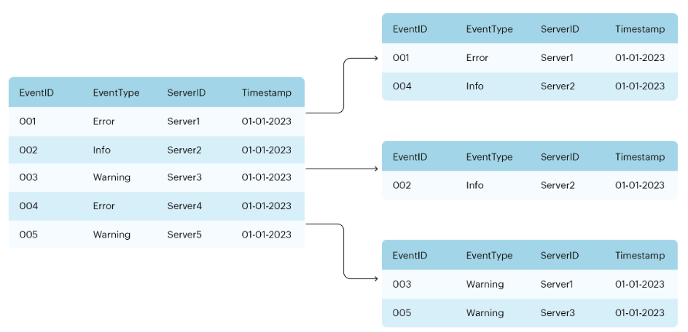
Partition Strategy and Key
Example
Server event data is divided into shards based on the EventType key. Each shard holds the data for a specific type of event (for example, Error, Info, and Warning).
Horizontally partitioning data based on a partition key

Slide 25
Partition Strategy and Key
Types of Partitions
Partitioning in Azure Cosmos DB is used to divide and categorize similar items into different containers called partitions. This approach gives the system flexibility and the ability to maintain and scale as required systemically. Also, it provides a streamlined approach to querying and using data within the application.
There are two types of partitions:
1) Logical Partitions and
2) Physical Partitions.
1) Logical Partitions
A Logical Partition is a partition where a set of items has the same partition key. In other words, this partition is created based on what data category we would like to look at.
Let's use the example of car manufacturing. What if we select the cars to be partitioned by car brand type (Ferrari, Ford, Honda, Mercedes, etc.)
Moreover, a logical partition also explains the scope of database transactions. That is to say, you can update items within a logical partition by using a transaction with snapshot isolation. And, when there is addition of new items to a container, then new logical partitions are transparently created by the system

Slide 26
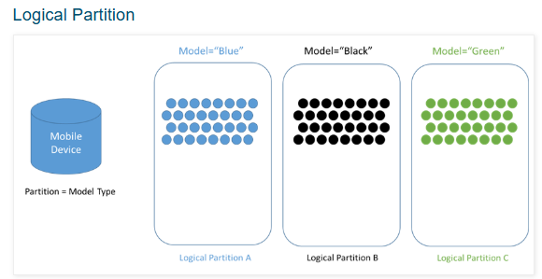
Partition Strategy and Key
.There is no limit to the number of logical partitions in your container as each logical partition can store up to 20GB of data.
2) Physical partitions
An Azure Cosmos container is scaled by distributing data and throughput across physical partitions. In this, internally there are one or more logical partitions that map to a single physical partition.
However, most small Cosmos containers have many logical partitions but only require a single physical partition. Physical partitions are an internal implementation of the system.

Slide 27
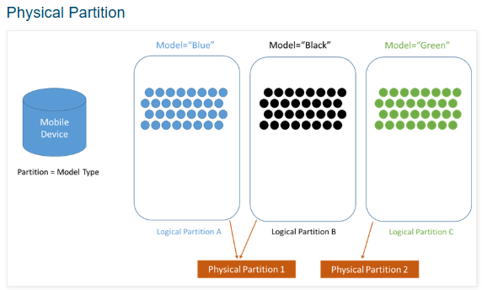
Partition Strategy and Key
Further, the number of physical partitions in your Cosmos container depends on the following:
Firstly, the amount of provisioned throughput in which each individual physical partition can provide a throughput of up to 10,000 request units per second.
Secondly, total data storage in which each individual physical partition can store up to 50GB.
However, there is no limit to the total number of physical partitions in your container. As provisioned throughput or data size grows, Azure Cosmos DB automatically creates new physical partitions by splitting existing ones. And, physical partition splits do not impact your application’s availability.
Next, after splitting the physical partition, all data within a single logical partition will still be stored on the same physical partition.

Slide 28
Partition Strategy and Key
Azure cosmo db partition key strategy
It's important to carefully choose the partition key to ensure efficient data distribution, scalability,
and performance. Cosmos DB uses partition keys to distribute data across physical partitions, which
helps it handle large amounts of data and high throughput workloads.
Here are key principles and strategies for selecting a partition key in Azure Cosmos DB:
1. Choose a High Cardinality Partition Key
High Cardinality means that the partition key should have a large number of unique values. This helps distribute the data evenly across physical partitions and avoids hotspots (where one partition is over-loaded with data).
Example: If you're building an e-commerce app, using CustomerId as the partition key can help, as each customer would likely have many orders, leading to a large number of partitions based on CustomerId.

Slide 29
Partition Strategy and Key
2. Ensure Even Data Distribution
Your partition key should distribute data evenly across all partitions to avoid bottlenecks. If too much data is concentrated in a single partition, it can cause hot partitions, which can negatively affect throughput and performance.
Example (Even Distribution):In a system that stores user activity logs, using UserId as the partition key ensures that logs from different users are evenly distributed across physical partitions.
3. Consider Read and Write Patterns
The partition key should also align with your typical query patterns. If you frequently query by a specific field, it's beneficial to use that field as the partition key to minimize cross-partition queries (which are more expensive in terms of RU consumption).
Example (Query Optimization):
If your application often queries data by CustomerId, using CustomerId as the partition key ensures that these queries are efficient because they’ll only target a single partition.

Slide 30
Partition Strategy and Key
4. Plan for Growth and Scalability
Cosmos DB automatically distributes data across physical partitions, but as the data grows, it may need to split partitions. It's important to choose a partition key that will scale as the system grows and not hit storage or throughput limits.
Example (Scalability):
Using OrderId or a timestamp as part of a partition key could help scale a large dataset of order records, ensuring that as your application grows, Cosmos DB can handle an increasing number of logical partitions.
5. Avoid "Hot Partition" Scenarios
A hot partition occurs when a disproportionate amount of requests (reads/writes) are sent to a single partition, overwhelming that partition while other partitions are underutilized.
To avoid this, select a partition key that generates a balanced load across all partitions.
Example of Hot Partition Problem:
Using a Region partition key when all traffic is concentrated in a single region, leading to one partition being overloaded while others are idle.

Slide 31
Partition Strategy and Key
6. Consider Write and Read Consistency
In certain scenarios, you might need to consider write and read consistency for your application. If you need strong consistency, data that is frequently accessed together should be in the same partition.
Example (Consistency Consideration):
If an application needs to frequently update and read an order's status, using a partition key like OrderId could ensure that related data resides within the same partition, improving consistency and reducing latency.
7. Avoid Overly Granular Partition Keys
While it is important to distribute data evenly, over-partitioning can occur if the partition key results in too many small partitions that lead to inefficient resource usage.
Example (Over-partitioning):
Using a very granular field like Timestamp (down to the second) might result in a huge number of partitions, each containing very little data, causing unnecessary overhead.
8. Consider Throughput and RU Consumption
Azure Cosmos DB uses Request Units (RUs) for billing, and cross-partition queries consume more RUs. Therefore, selecting a partition key that aligns with your query patterns helps reduce RU consumption.

Slide 32
Query Types
Azure Cosmos DB provides several query options to interact with your data, depending on your use case and the type of Cosmos DB API you're using.
Query types supported across different Cosmos DB APIs:
1. SQL (Core) API Queries
SQL Queries: Cosmos DB's SQL API allows you to query your data using a SQL-like syntax. These queries are used to retrieve, filter, and manipulate JSON data stored in Cosmos DB containers.
Example SQL Query:
sqlCopySELECT c.id, c.name FROM c WHERE c.age > 25 ORDER BY c.name
2. MongoDB API Queries:
Cosmos DB also supports the MongoDB API, which allows you to use MongoDB's query syntax.You can execute MongoDB-style queries to interact with the data stored in Cosmos DB, you can also use MongoDB query operators like $eq, $gt, $lt, $in, $or, $and, etc.
Example MongoDB Query:
jsonCopydb.users.find({ "age": { "$gt": 25 }, "status": "active" })

Slide 33
Query Types
3. Cassandra API Queries:
For Cosmos DB configured with the Cassandra API, you use the CQL (Cassandra Query Language) to query the data.CQL is similar to SQL but optimized for Cassandra’s distributed architecture. It supports SELECT, INSERT, UPDATE, and DELETE operations.
Example CQL Query:
sqlCopySELECT name, age FROM users WHERE age > 25 AND status = 'active';
4. Gremlin API Queries (Graph Queries):
Cosmos DB with the Gremlin API supports graph queries using the Gremlin query language.
Gremlin is designed for querying graph databases and supports traversal operations on nodes and edges.
Graph Traversal Operations:
In the Gremlin API, queries are composed of traversals to nodes and edges in the graph, using various steps like has(), out(), in(), value(), etc.
Example Gremlin Query:
gremlinCopyg.V().hasLabel('person').has('age', gt(25)).values('name')

Slide 34
Query Types
5. Table API Queries
For Cosmos DB configured with the Table API, queries are similar to those used in Azure Table Storage.
You can use the OData query syntax for filtering and querying data.
Example Table Query:
CopyGET /tables/Users?$filter=Age gt 25 and Status eq 'active‘
6. Full-text Search (Azure Cosmos DB with Azure Cognitive Search)
If you use Cosmos DB with Azure Cognitive Search, you can perform full-text search queries that provide more advanced capabilities like text searching, ranking, and filtering based on text content.
The queries use the OData or Lucene query syntax and are often used for searching large text fields.
Example Full-text Search Query:
CopyGET /docs?search="search term"&$filter=category eq 'books'

Slide 35
Azure Virtual Network (VNet)
The Azure Virtual Network empowers secure communication among Azure services
Connecting them seamlessly to the internet as well as on-premises network
OR
An Azure Virtual Network (VNet) is a network or environment that can be used to run
VMs and applications in the cloud.
When it is created, the services and Virtual Machines within the Azure network
interact securely with each other.
OR
It is a representation of the on-premises network on the cloud.
It helps us logically isolate the Azure cloud network dedicated to our subscription.
It helps us to manage and provision virtual private networks in Azure,
link the virtual networks with other virtual networks in Azure,
or with on-premises IT infrastructure and networks that help us create hybrid
or cross-premises solutions.

Slide 36

Advantages of Using Azure Virtual Network
Some of the major advantages of using Microsoft Azure VNet are as follows:
It provides an isolated environment for your applications
A subnet in a VNet can access the public internet by default
We can easily direct traffic from resources
It is a highly secure network
It has high network connectivity
It builds sophisticated network topologies in a simple manner
Icon of VNet

Slide 37
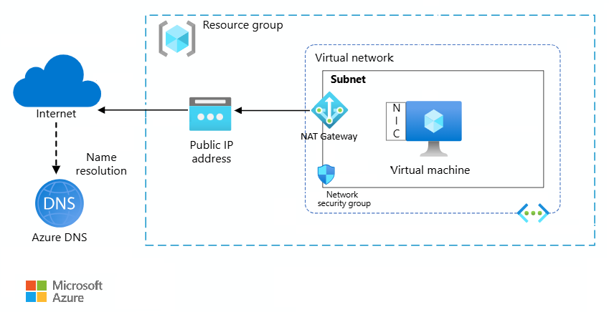
Elements of Azure Virtual Network:

Slide 38
Elements of Azure Virtual Network:
Subnets: Subnets can be used to split up a virtual network into smaller, simpler networks. It is possible to designate each subnet to a different security zone and control traffic between subnets using network security groups.
Network Security Groups: Network traffic between subnets or between virtual machines (VMs) inside a subnet is filtered using NSGs. The source or destination IP address, port number, or protocol can all be used to define rules in an NSG that allow or refuse communication.
Virtual Network Interface Cards: Virtual Network Interface Cards will help our VMs to other resources via the internet. Each VM can have more than one NIC.
Virtual Private Network Gateway: Virtual Private Network Gateway (VPNG) technology can link on-premises resources to cloud resources.
Azure Application Gateway: You may manage and scale web applications using the load balancer for web traffic known as Azure Application Gateway. It offers SSL offloading, URL-based routing, cookie-based session affinity, and web application firewall (WAF) features.

Slide 39
Azure Traffic Manager :
Azure Traffic Manager(ATM) allows you to regulate the distribution of user traffic by using DNS to direct requests to the most appropriate service endpoint supported on a traffic-routing method and therefore the health of the endpoints.
Azure traffic manager selects an endpoint based on the configured routing method.
It supports a variety of traffic-routing methods to suit different application needs.
After the selection of endpoints, the client is connected directly to the appropriate service point.
It also provides endpoint health checks and automatic failover.
It also enables you to build a highly available application that is resilient to failure, including the failure of an entire Azure region

Slide 40
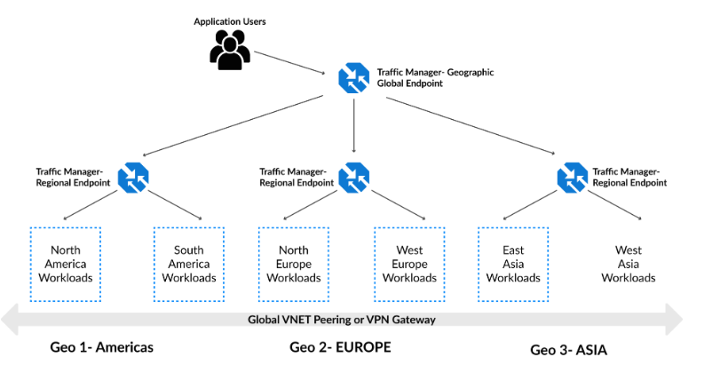
Azure Traffic Manager :

Slide 41
Use Traffic Manager
Azure Traffic Manager(ATM) uses DNS to direct client requests to the most appropriate service endpoint based on a traffic-routing method and the health of the endpoints.
An endpoint is any Internet-facing service hosted inside or outside of Azure.
It provides a range of traffic-routing methods and endpoint monitoring options to suit different application needs and automatic failover models.
It is resilient to failure, including the failure of an entire Azure region.

Slide 42
Azure Traffic Manager Routing Methods
Azure Traffic Manager distributes the traffic based on one of the six traffic-routing methods that determine which endpoint is returned within the DNS response.
Priority Routing- It has a priority list of service endpoints where the primary service endpoint has the highest priority.
Weighted Routing - It is used to distribute traffic evenly across a set of endpoints.
Performance Routing- It is used when we want to improve the response time of applications by routing traffic to the location nearest to the user
Geographics Routing- In this the endpoint associated with a traffic manager profile must have a pre defined geographic region assigned to it.
Multivalue Routing- It returns multiple endpoint for a single query, it can only be set to IPv4/IPv6 addresses as endpoints.
Subnet Routing- It maps a set of users IP address to a specific endpoint.

Slide 43
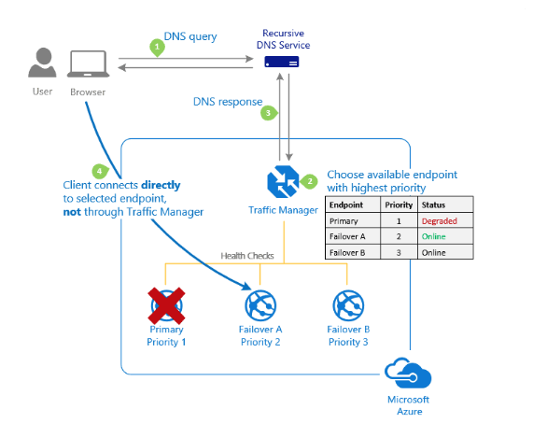
1) Priority Routing:
When you select the priority routing method, it contains a prioritized list of service endpoints where the primary service endpoint has the highest priority for all traffic.
If the primary service endpoint is unavailable, it redirects the traffic to the second priority endpoint and so on.

Slide 44
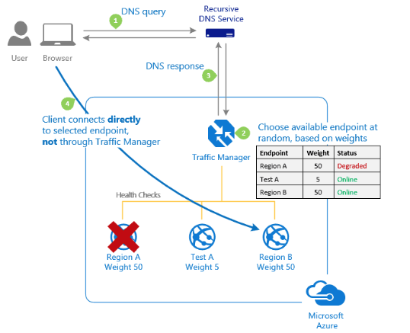
2) Weighted Routing
The weighted routing method is used when you want to distribute traffic evenly or to use pre-defined weights across a set of endpoints.
In this traffic-routing method, allocate a weight which is an integer from 1 to 1000, to each endpoint in the Microsoft Azure Traffic Manager profile configuration.

Slide 45
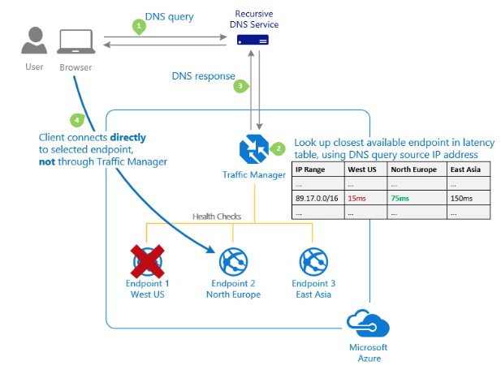
3) Performance Routing
This traffic routing method is used when you want to improve the responsiveness of many applications by routing traffic to the location that is closest to the user.
The ‘closest’ endpoint isn’t necessarily closest as measured by geographic distance.
Instead, the ‘Performance’ traffic-routing method determines the closest endpoint by measuring network latency.

Slide 46
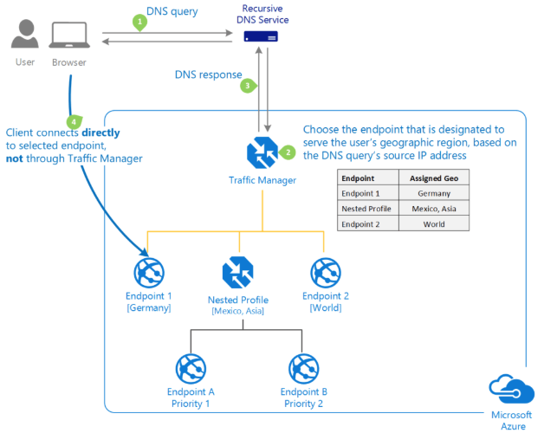
4) Geographic Routing
In Geographic routing, each endpoint associated with that profile must have a set of geographic regions assigned thereto.
When a region or a set of regions is assigned to an endpoint, any requests from those regions get routed only thereto endpoint.

Slide 47
5) Multivalue Routing
Select MultiValue for Azure Traffic Manager profiles which may only have IPv4/IPv6 addresses as endpoints.
When a question is received for this profile, all healthy endpoints are returned.
6) Subnet Routing
Select the Subnet traffic-routing method to map sets of end-user IP address ranges to a specific endpoint within an Azure Traffic Manager profile.
When a request is received, the endpoint returned are getting to be the one mapped for that request’s source IP address.

Slide 48
Features Of Azure Traffic Manager
1) Increase application availability
It provides high availability for your critical applications by monitoring your endpoints and delivering automatic failover when an endpoint goes down.
2) Improve application performance
Azure allows you to run cloud services or websites in data centres located all over the world. It enhances application responsiveness by directing traffic to the endpoint with the lowest network latency for the client.
3) Perform service maintenance without downtime
It perform planned maintenance operations on your applications without downtime. It can direct traffic to alternative endpoints while the unkeep is ongoing.
4) Combine hybrid applications
Microsoft Azure Traffic Manager supports external, non-Azure endpoints enabling it to be used with hybrid cloud and on-premises deployments, including the “burst-to-cloud”, “migrate-to-cloud,” and “failover-to-cloud” scenarios.
5) Distribute traffic for complex deployments
Using nested Azure Traffic Manager profiles, multiple traffic-routing methods are often combined to make sophisticated and versatile rules to scale to the requirements of larger, more complex deployments.

